Slide 1
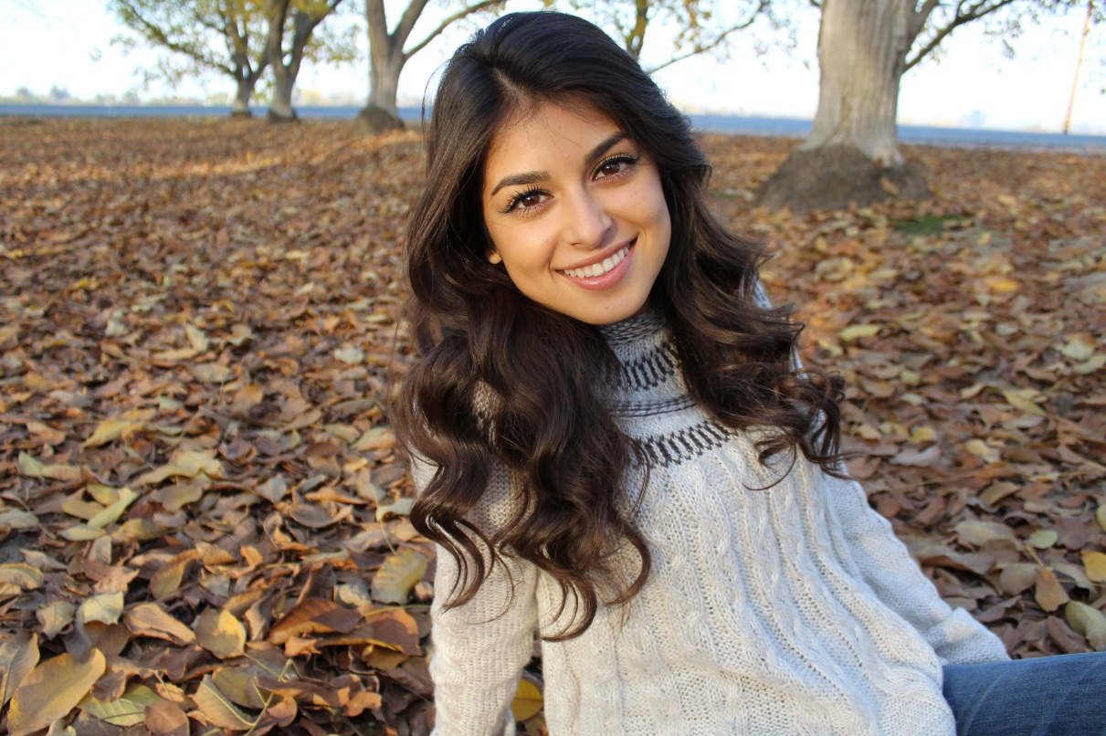
Alondra Garcia
Class of 2017

Slide 2
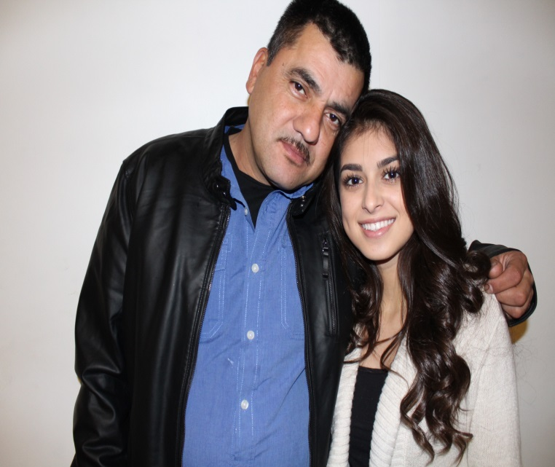
About Me
Born in Visalia, California
17 years old
Family of 3

Slide 3
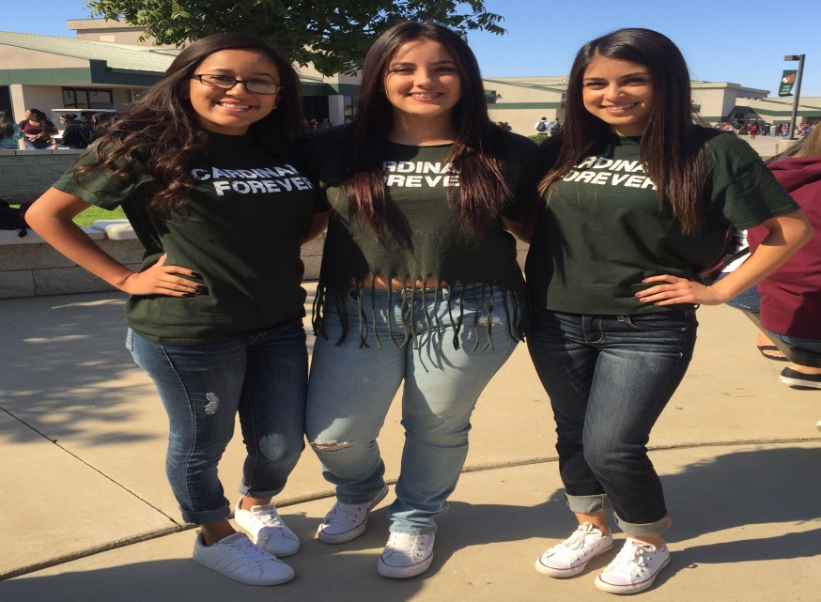
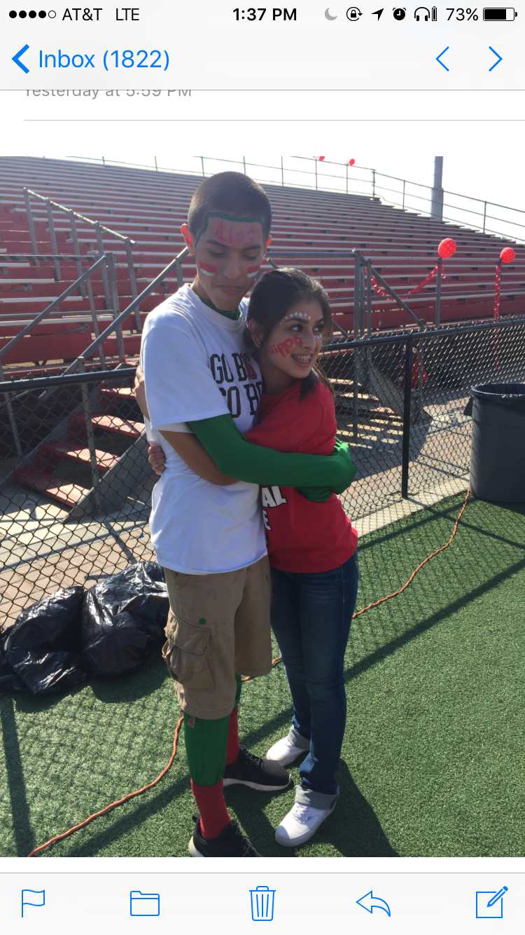
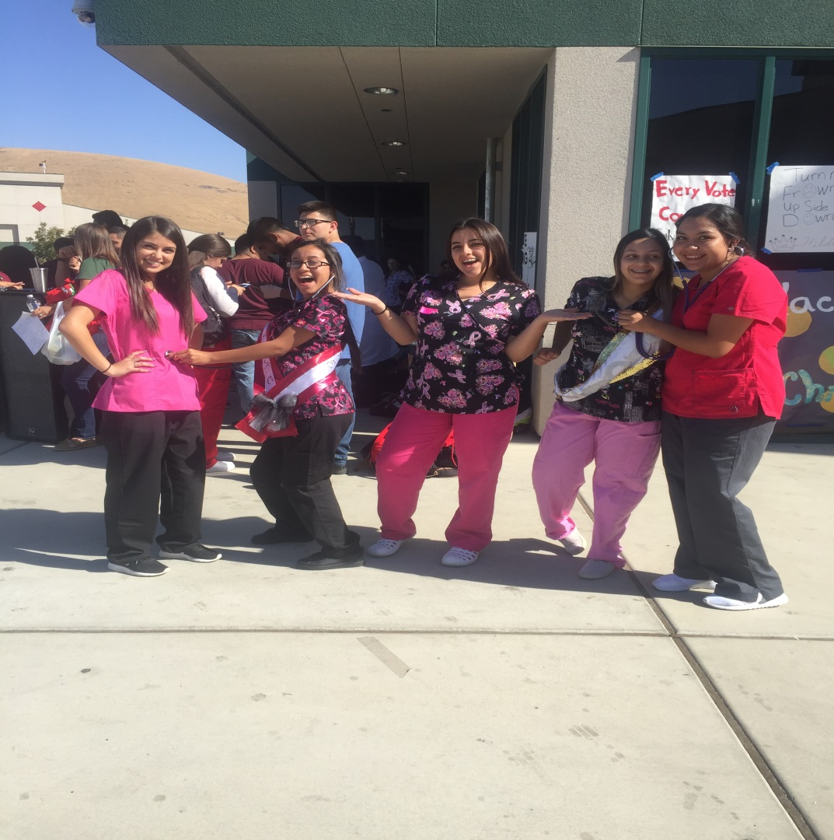
High school experiences
ASB
Key Club
My Voice
CNA

Slide 4
pathway
Spanish
Spanish 1
Spanish Speakers
AP Spanish
Bilingual
Adios
Goodbye

Slide 5
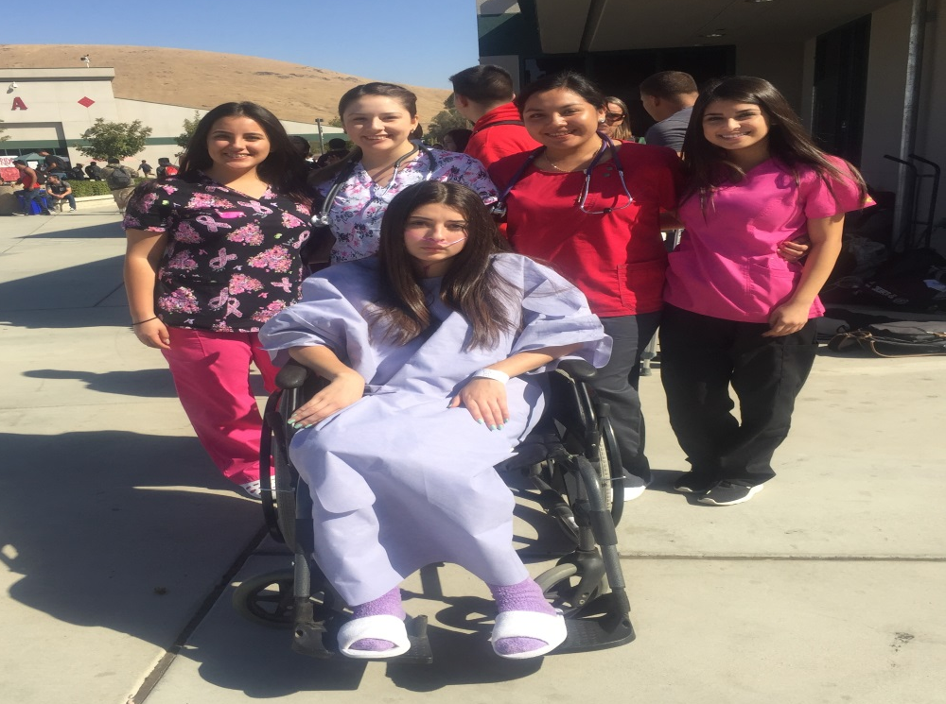
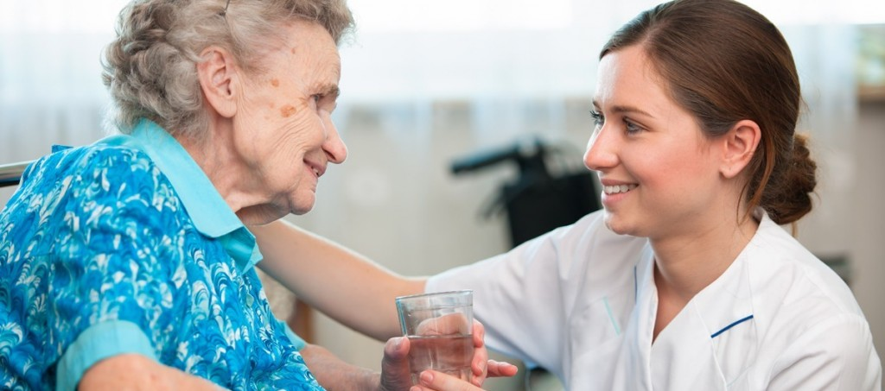
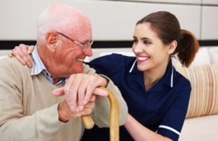
Job shadow
Lindsay Gardens
Celeste Lemus
Requirements
Patience
Communication Skills

Slide 6
Post-high school plans
Attend 2 year Community College
COS
Transfer 4 year University
Long Beach
Major in Nursing

Slide 7
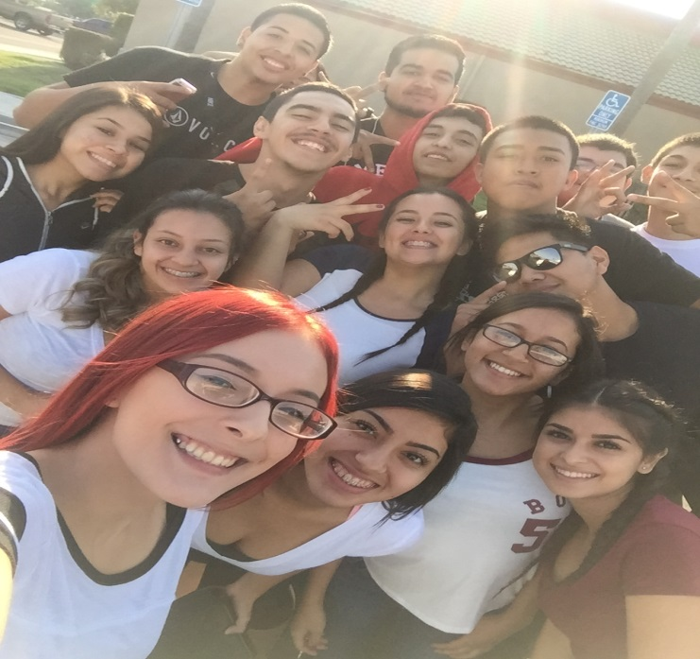
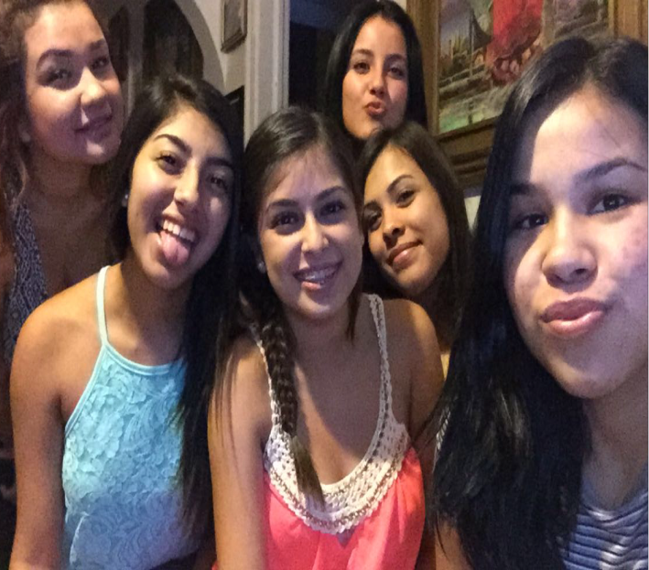
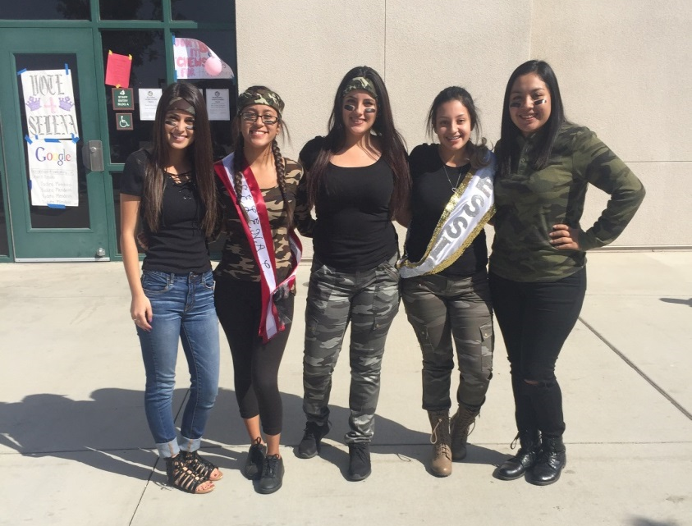
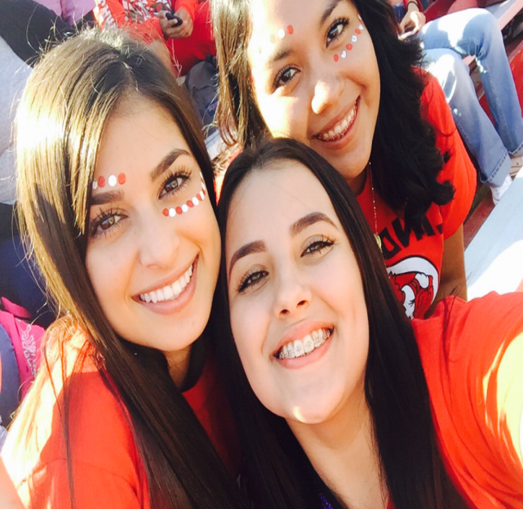
Overall Experience
PBS system
Independent
PLT
Responsibility
Memories

Slide 8
Thank you for your time
Questions??

